Slide 1
TCL SCRIPTING

Slide 2
Course Objectives
By the end of this course, you will be able to
● Explain Tcl scripting
● Identify Tcl uses and strengths
● Write simple Tcl scripts
● Demonstrate the Tcl usage for EDA scripting

Slide 3
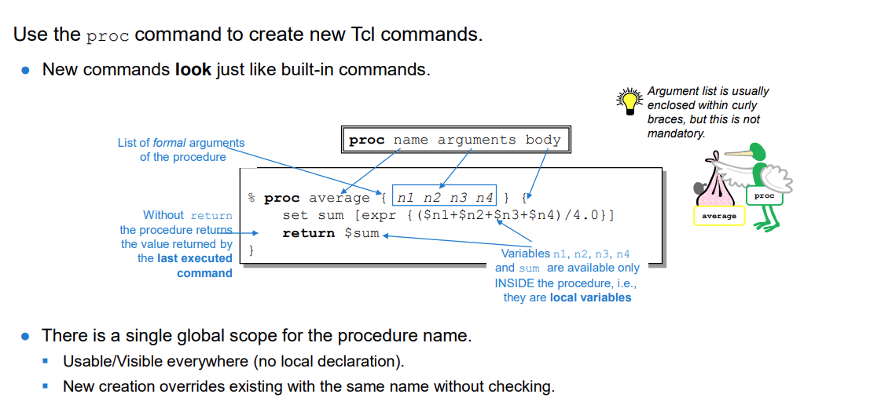
Basic Procedures

Slide 4
Syntax:
proc <proc name> <param list> <proc body>
“info body” returns the body of a procedure:
% info body average
set sum [expr {($n1+$n2+$n3+$n4)/4.0}]
return $sum
“info args” returns the arguments of a procedure:
% info args average
n1 n2 n3 n4
“info commands” lists all built-in plus all user-defined commands/procedures:
% info commands a*
auto_load_index auto_import auto_execok average array auto_mkindex auto_reset
auto_qualify auto_load append after
auto_mkindex_old

Slide 5
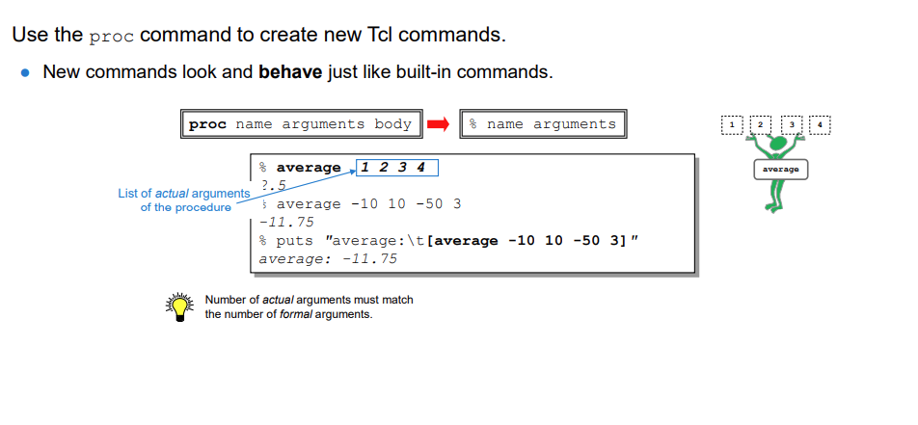
Basic Procedures (continued)
Examples
% average 1 2 wrong # args: should be "average n1 n2 n3 n4“
% average 1 2 3 4 5 wrong # args: should be "average n1 n2 n3 n4“

Slide 6
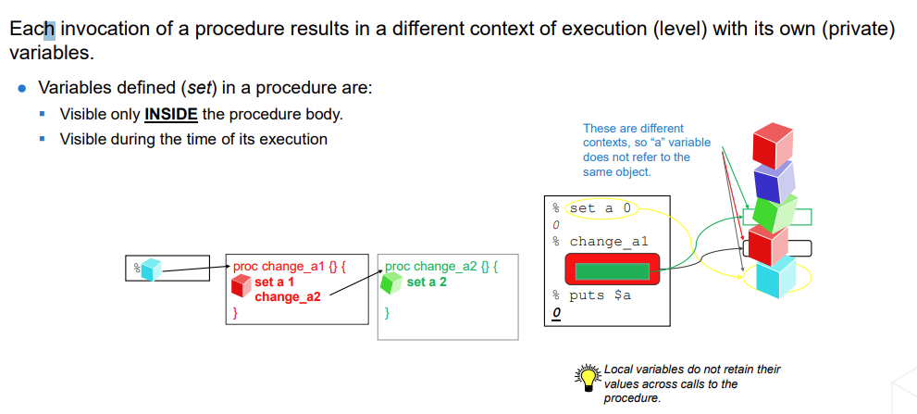
Local Variables

Slide 7
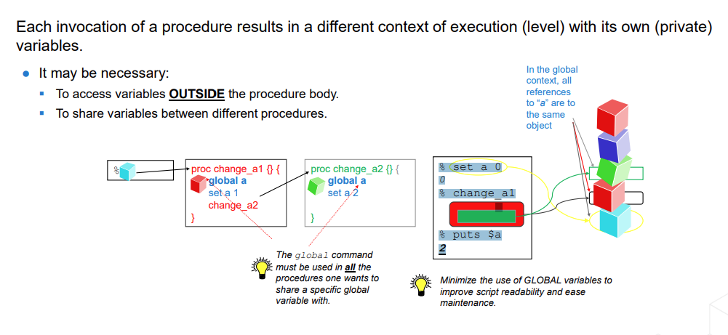
Global Variables

Slide 8
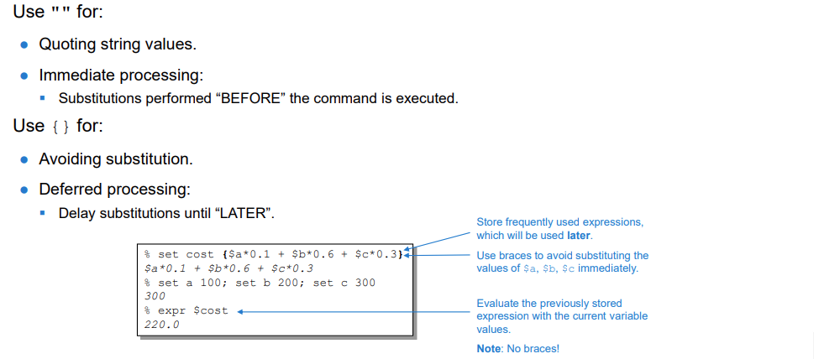
When Do I Use "" and {}?

Slide 9
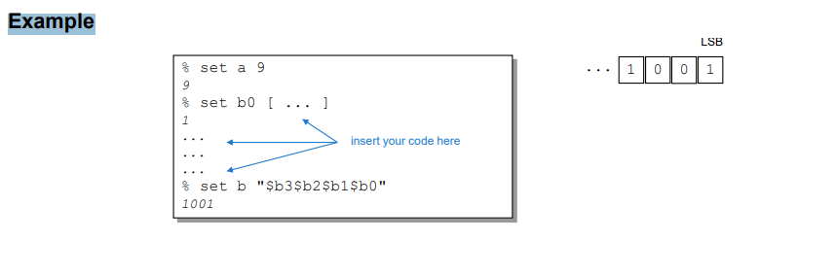
Extracting Bits from Integers
Using a Tcl interpreter in an interactive mode, extract 4 least significant bits from a positive integer number between 0 and 15.

Slide 10
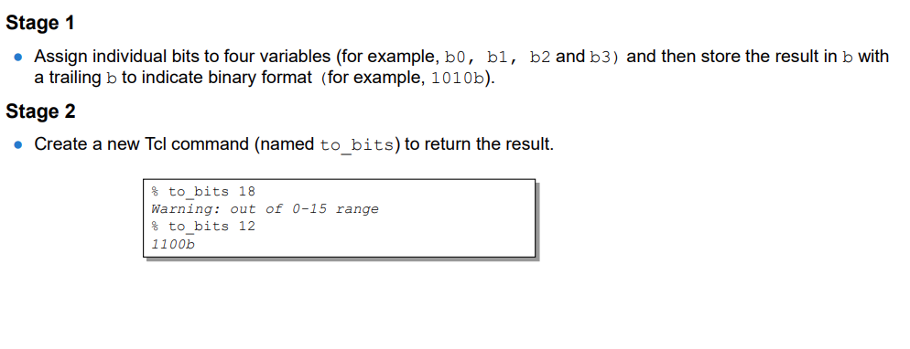
Extracting Bits from Integers

Slide 11
Assign individual bits to four variables (for example, b0, b1, b2 and b3) and then store the result in b with a trailing b to indicate binary format (for example, 1010b).
Hints
▪ Stage 1
• Use the expr Tcl command with the following arithmetic operators:
$a >> 1 Shifts content of variable a right by 1 bit
$a & 1 Applies bit-wise AND on the contents of variable a to extract the least significant bit
▪ Stage 2
• Print a warning message if the input value is outside the valid 0–15 range.
• Use the expr Tcl command with the following arithmetic operators:
… ? … : … Ternary operator
• Syntax
expr { cond ? [cmd_to_be_executed_if_cond_is_true ]: \ [cmd_to_be_executed_if_cond_is_wrong ] }
• Example
expr {$n>15 ? [return "Out of range" ]: [return $val ] }

Slide 12
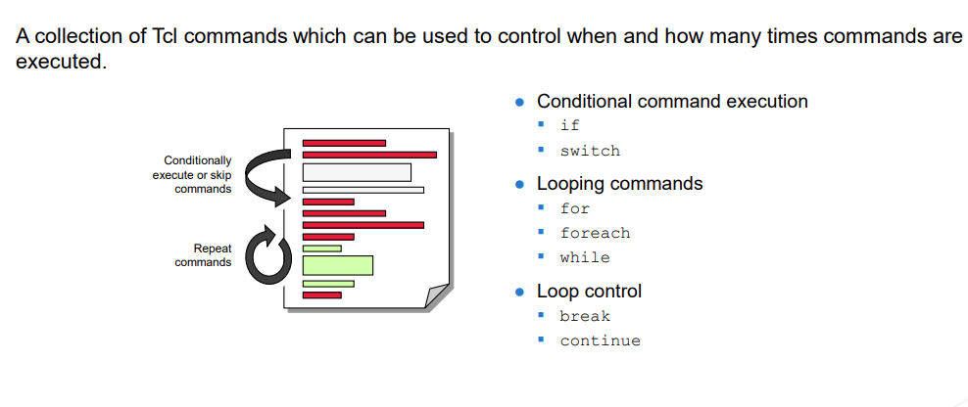
What Is Control Flow?

Slide 13
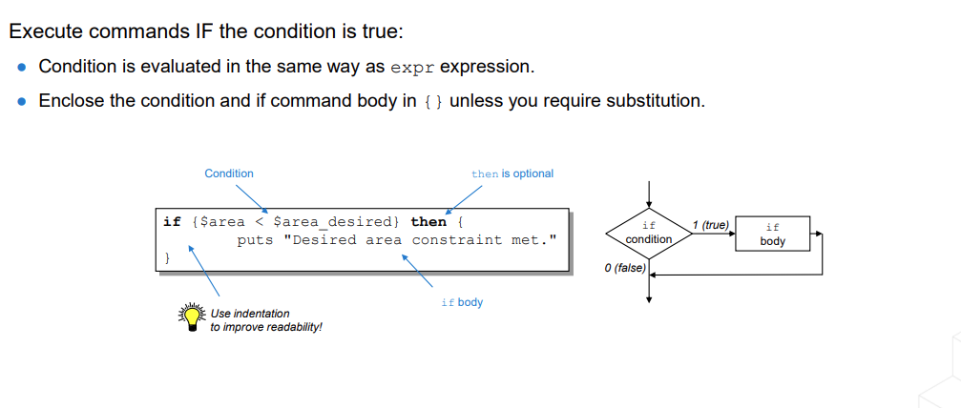
Conditional Execution: if

Slide 14
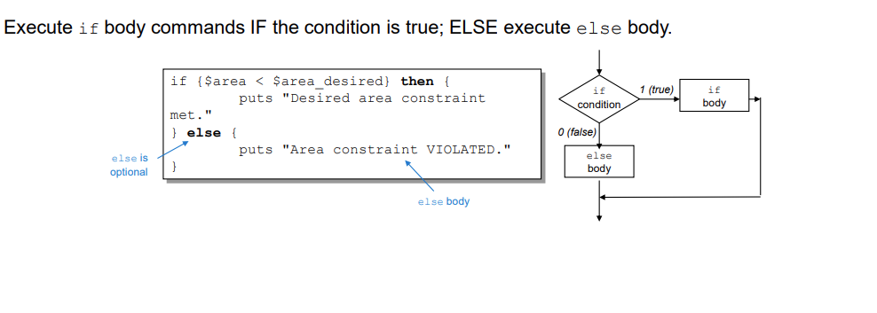
Conditional Execution: if-else

Slide 15
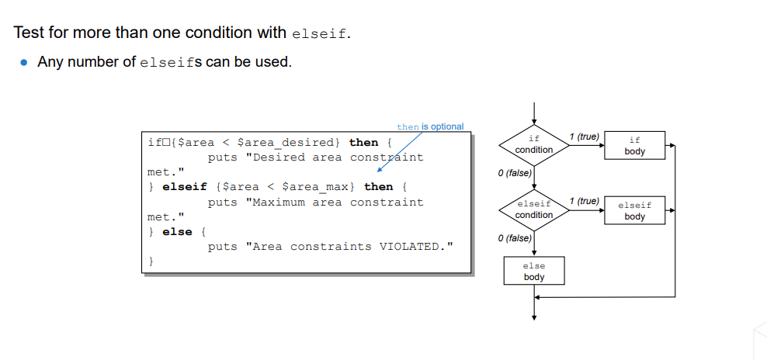
Conditional Execution: if-elseif-else

Slide 16
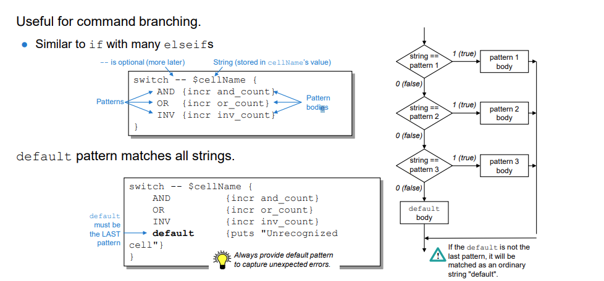
Conditional Execution: switch

Slide 17
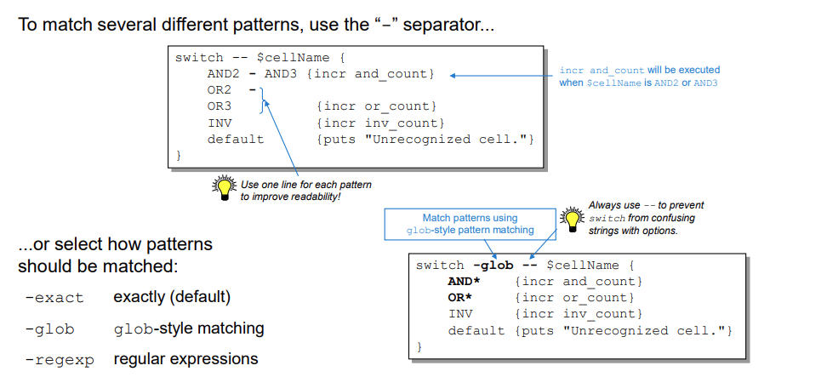
Matching Multiple Patterns with switch

Slide 18
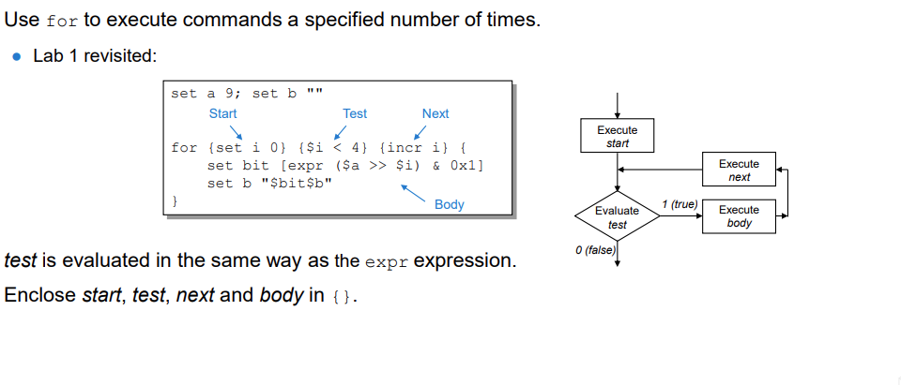
Looping: for

Slide 19
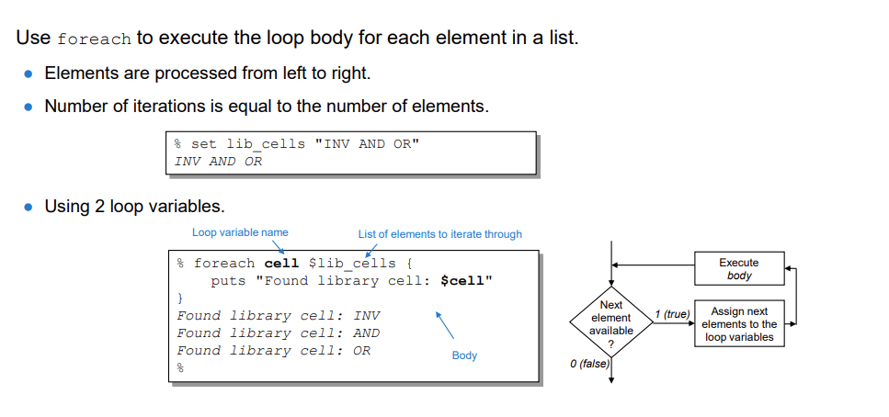
Looping: foreach

Slide 20
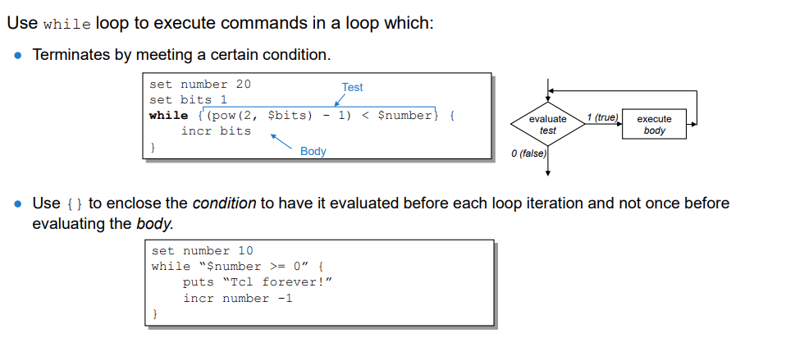
Looping: while

Slide 21
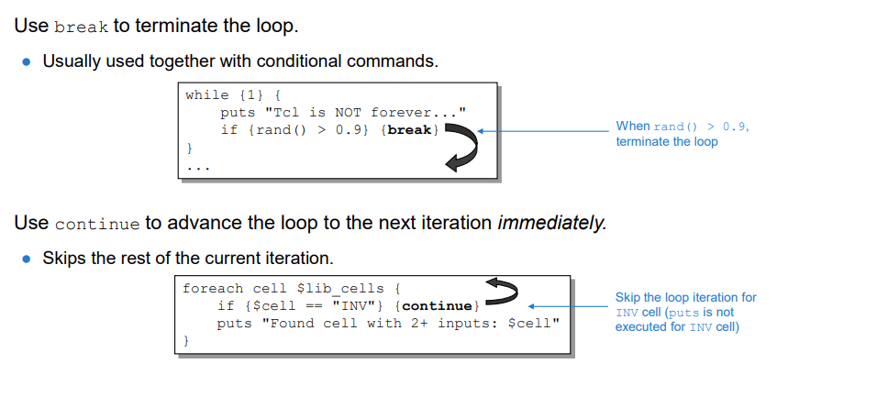
Loop Control: break and continue

Slide 22
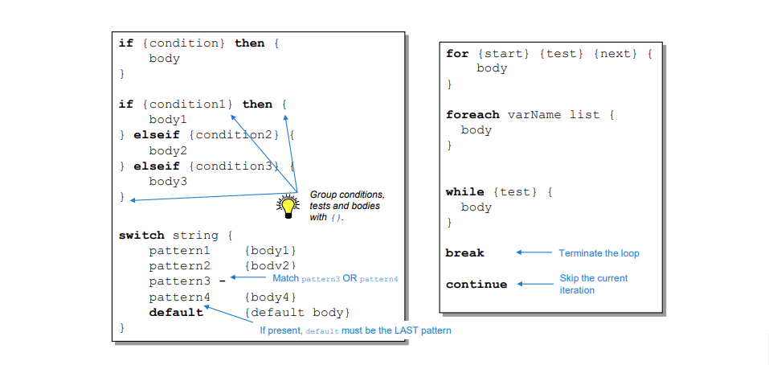
Control Flow: Syntax Summary

Slide 23
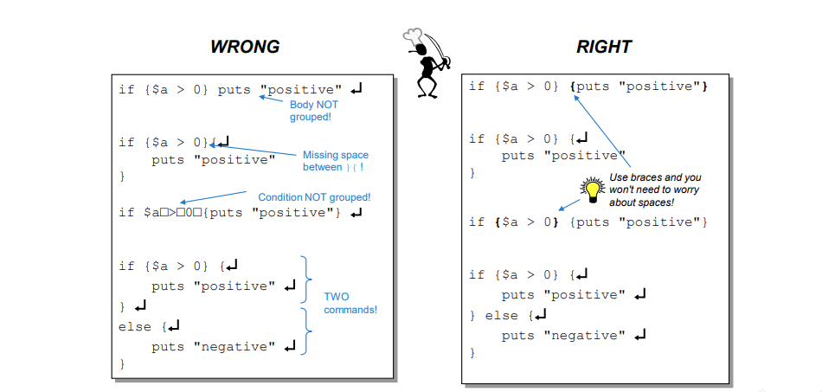
Braces and Spaces (Grouping Mistakes)

Slide 24
What Is a String?
● In Tcl, everything is by default a string
● Any collection of characters, letters, digits, special characters, binary characters, etc.
● Universal data type from/to which everything can be converted
● Easy to manipulate

Slide 25
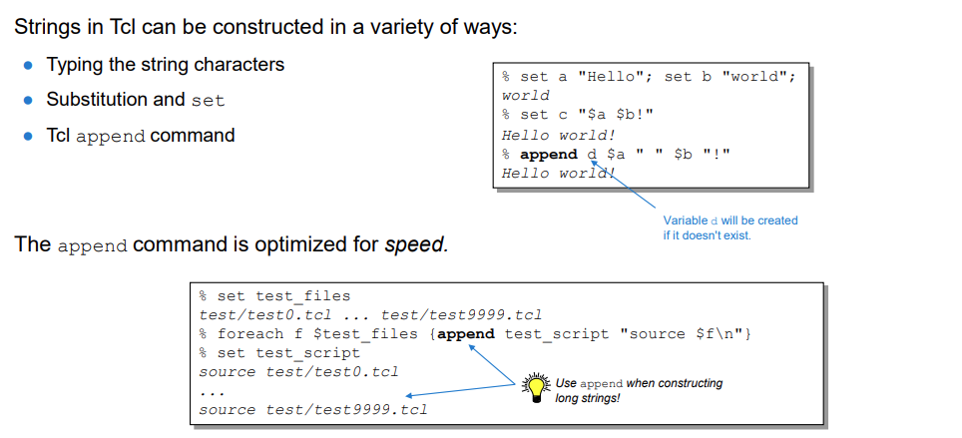
Constructing Strings

Slide 26
Syntax:
append varName ?value value ...?
It might seem that there is no justification for having append, when the same effect can be achieved using substitution. However, the append command is significantly faster when constructing long strings. In the example above, if the body of the foreach loop is replaced with:
set test_script "${test_script}source $f\n"
the loop will be 200 times slower!
Try source examples/append_vs_set.tcl.

Slide 27
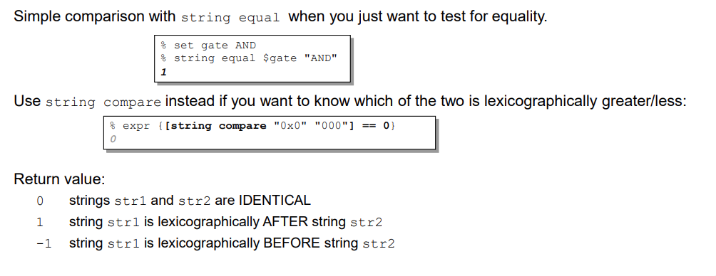
Comparing Strings

Slide 28
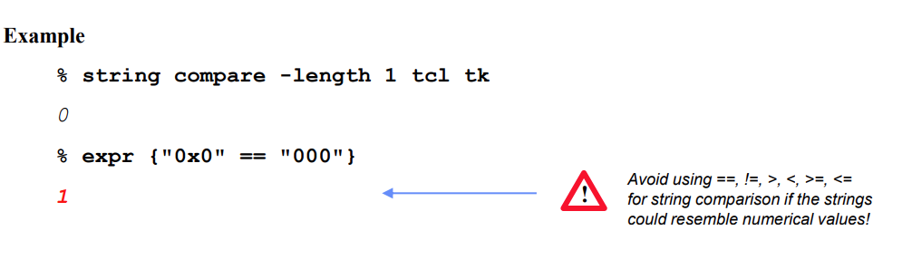

Slide 29
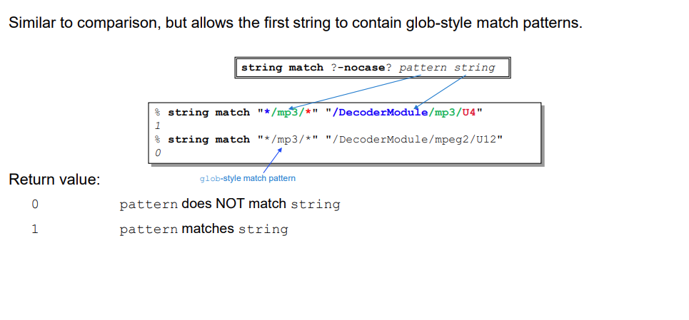
String Matching

Slide 30
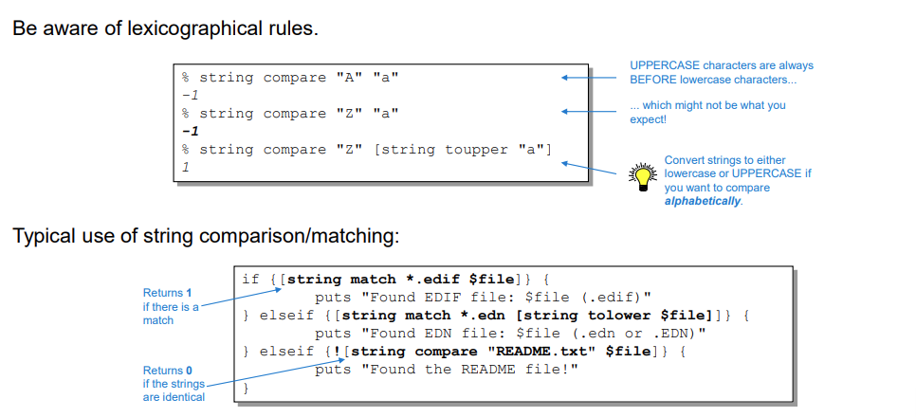
Examples: Comparing/Matching Strings

Slide 31
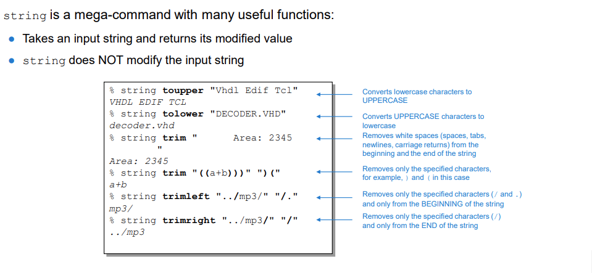
Other Useful String Commands

Slide 32
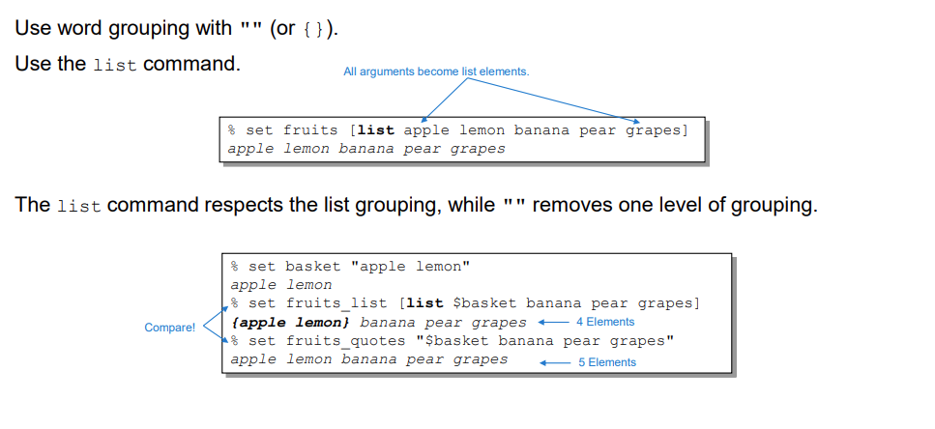
Building Lists

Slide 33
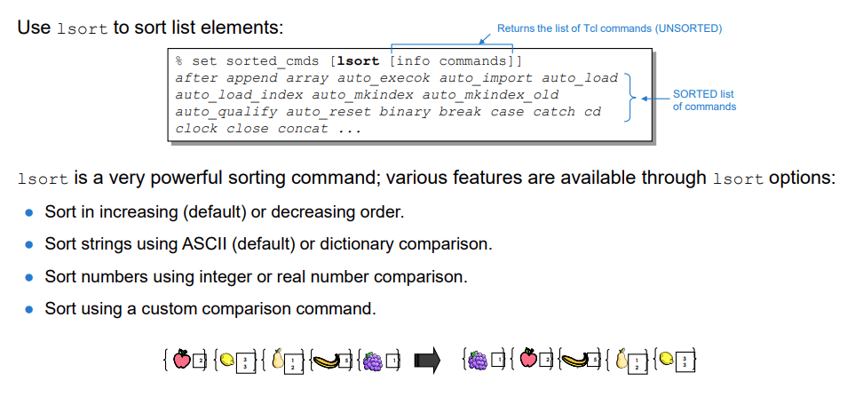
Sorting Lists

Slide 34
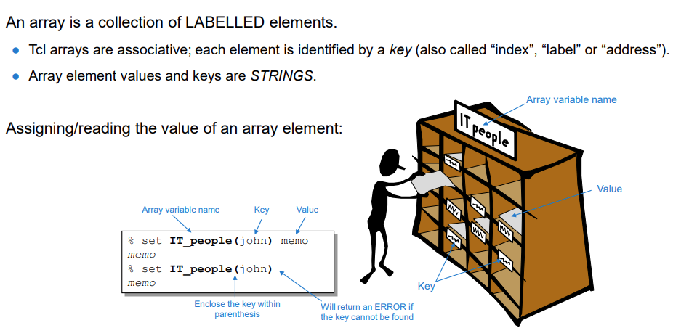
What Is an Array?

Slide 35
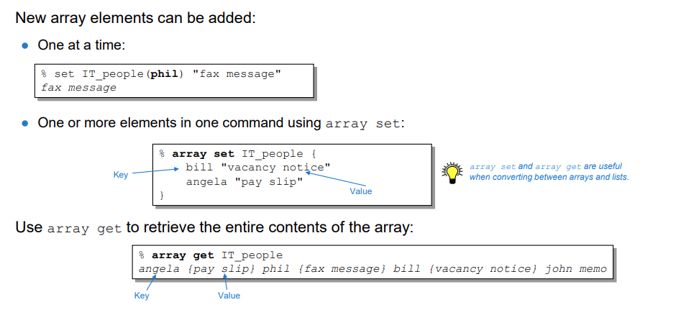
Manipulating Arrays

Slide 36
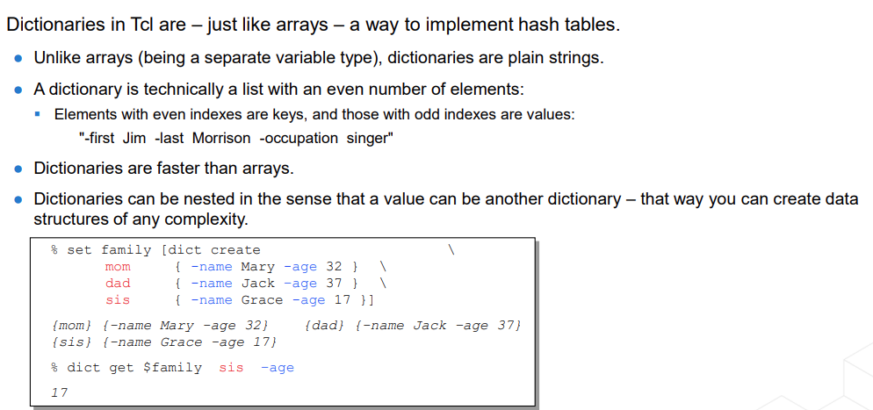
What Is a Dictionary in Tcl?

Slide 37
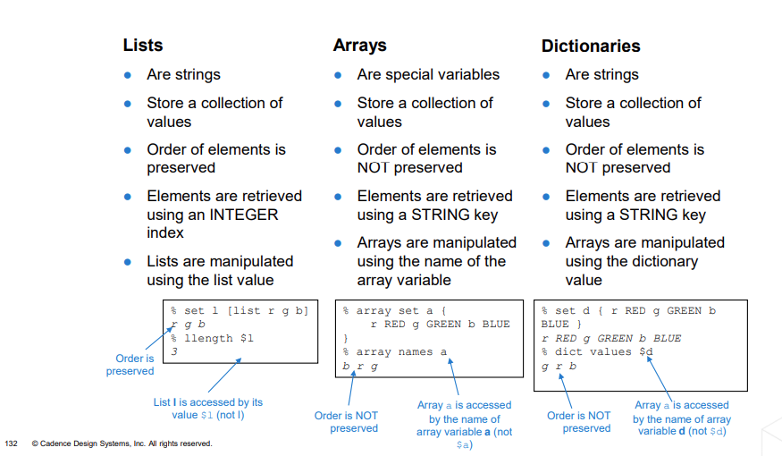



















Lists Versus Arrays Versus Dictionaries

